Slide 1
The Data Science Process
Identify the question
Get the data
Clean the data
Explore the data
Model the data
Communicate the results

Slide 2
The Data Science Process
Identify the question
Get the data
Clean the data
Explore the data
Model the data
Communicate the results

Slide 3
The Data Science Process
Identify the question
Get the data
Clean the data
Explore the data
Model the data
Communicate the results

Slide 4
Machine Learning

Slide 5
What is Machine Learning?

Slide 6
Traditional Software Development

Slide 7
Traditional Software Development
Convert inches to cm

Slide 8
Traditional Software Development
Convert inches to cm
Input:
Output:

Slide 9
Traditional Software Development
Convert inches to cm
Input: inches
Output:

Slide 10
Traditional Software Development
Input: inches
Relationship: cm =
Output:

Slide 11
Traditional Software Development
Input: inches
Relationship: cm = inches * 2.54
Output:

Slide 12
Traditional Software Development
Input: inches
Relationship: cm = inches * 2.54
Output: cm

Slide 13
Traditional Software Development

Slide 14
Traditional Software Development
Convert a number to its absolute value

Slide 15
Traditional Software Development
Convert a number to its absolute value
Input:
Output:

Slide 16
Traditional Software Development
Convert a number to its absolute value
Input: number
Output:

Slide 17
Traditional Software Development
Convert a number to its absolute value
Input: number
Rules:
Output:

Slide 18
Traditional Software Development
Input: number
Rules:
if number >= 0: abs. value = number
Output:

Slide 19
Traditional Software Development
Input: number
Rules:
if number >= 0: abs. value = number
Output:

Slide 20
Traditional Software Development
Input: number
Rules:
if number >= 0: abs. value = number
else: abs. value = number * -1
Output:

Slide 21
Traditional Software Development
Input: number
Rules:
if number >= 0: abs. value = number
else: abs. value = number * -1
Output: abs. value

Slide 22
Traditional Software Development

Slide 23
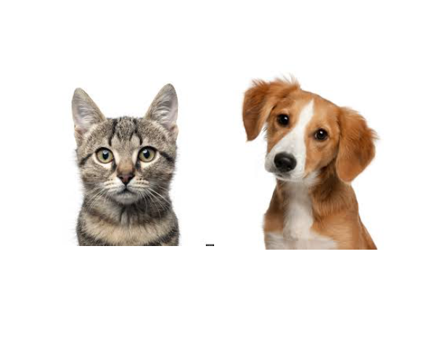
Traditional Software Development

Slide 24
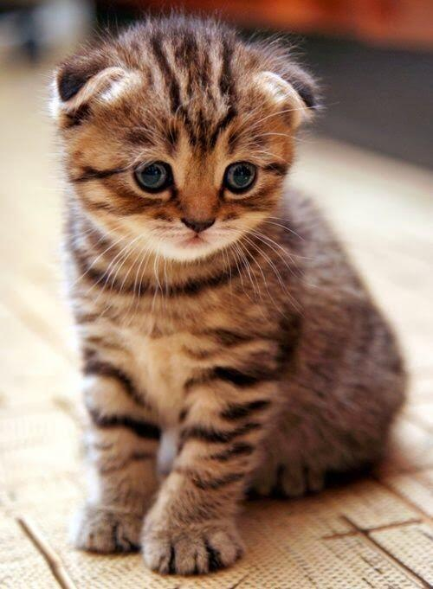

Slide 25
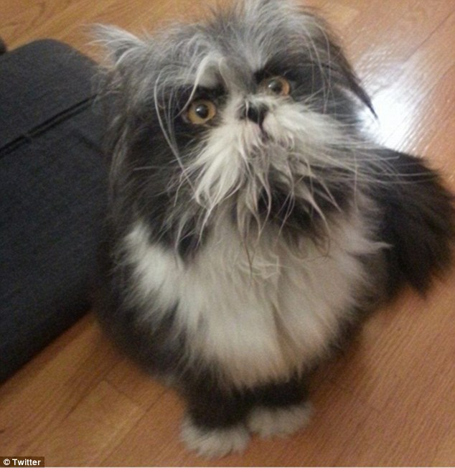

Slide 26
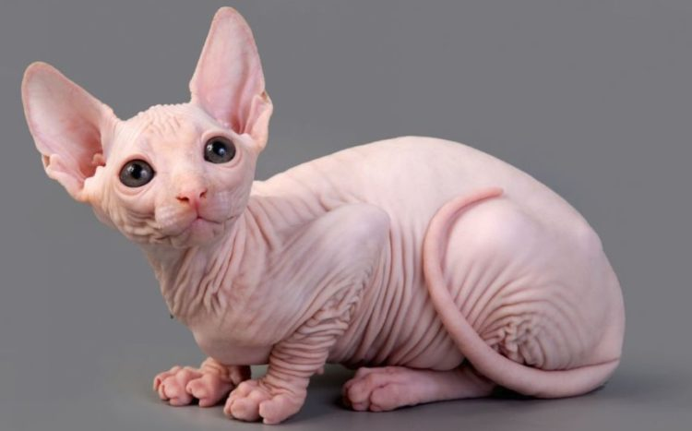

Slide 27
Traditional Software Development
Input:
Rules:
Output:

Slide 28
Traditional Software Development
Input:
Rules: rule 1
rule 2
rule 3 …
Output:

Slide 29
Traditional Software Development
Input:
Rules: rule 1
rule 2
rule 3 …
Output: “cat”

Slide 30
Machine Learning

Slide 31
Machine Learning
Input | 0 | 8 | 15 | 22 | 38
Output | 32 | 46.4 | 59 | 71.6 | ?

Slide 32
Machine Learning
Input | 0 | 8 | 15 | 22 | 38
Output | 32 | 46.4 | 59 | 71.6 | 100.4

Slide 33
F = C * 1.8 + 32
Celsius | 0 | 8 | 15 | 22 | 38
Fahrenheit | 32 | 46.4 | 59 | 71.6 | 100.4

Slide 34
Machine Learning
Input: [0, 8, 15 22]

Slide 35
Machine Learning
Input: [0, 8, 15 22]
Output: [32, 46.4, 59, 71.6]

Slide 36
Machine Learning
Input: [0, 8, 15 22]
Relationship: ?
Output: [32, 46.4, 59, 71.6]

Slide 37

Common ML Algorithms
Linear Regression
Logistic Regression
Naïve Bayes
Support Vector Machine
Decision Tree
K-Nearest Neighbor
=

Slide 38
Machine Learning
Input: [0, 8, 15 22]
Relationship:
Output: [32, 46.4, 59, 71.6]

Slide 39
Machine Learning
Input: [0, 8, 15 22]
Relationship: input *1.8 + 32
Output: [32, 46.4, 59, 71.6]

Slide 40
Machine Learning
Input: [0, 8, 15 22]
Model
Relationship: input *1.8 + 32
Output: [32, 46.4, 59, 71.6]

Slide 41
Machine Learning
ML Model
input *1.8 + 32

Slide 42
Machine Learning
ML Model
New input: 38
input *1.8 + 32

Slide 43
Machine Learning
ML Model
New input: 38
input *1.8 + 32
output: 100.4

Slide 44


DATA
ALGORITHM
MODEL

Slide 45

DATA
ALGORITHM
MODEL
NEW DATA
MODEL
PREDICTIONS

Slide 46
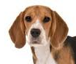
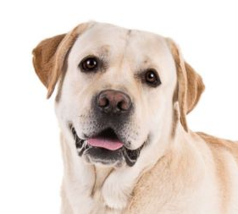


Machine Learning
Input:[ , , , ]
Relationship:
Output: [“cat”, “dog”, “dog”, “cat]

Slide 47
Machine Learning
Input:[ , , , ]
Relationship:
Output: [“cat”, “dog”, “dog”, “cat]

Slide 48
Pareidolia

Slide 50
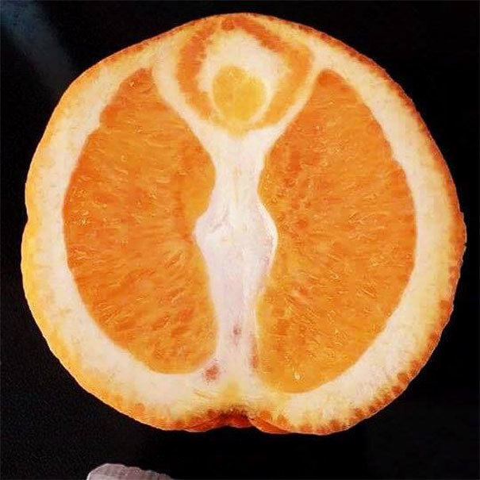

Slide 51
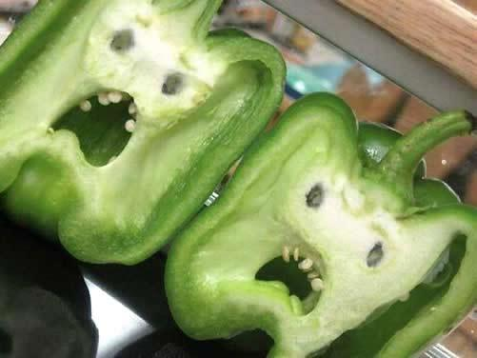

Slide 52
Machine Learning
Instead of programming a computer, you give a computer examples and it learns what you want.

Slide 53
Why ML Now?

Slide 54
Why ML Now?
Increasing availability of data

Slide 55
Why ML Now?
Increasing availability of data
Sophistication of ML algorithms

Slide 56
Why ML Now?
Increasing availability of data
Sophistication of ML algorithms
Increasing power and availability of computing hardware and software

Slide 57
Types of Machine Learning

Slide 58
Supervised
Unsupervised

Slide 59

Music
Song | Artist | Genre | Liked
Breathing Light | Frameworks | Alternative Rock | Yes
Superior | Silver Maple | Pop | No
Icicle | AK | Pop | No
Jazzin | Flap Jack | R&B | Yes
The Way You Do | Schlomo | R&B | Yes
Mirror Maru | Cashmere | Rock | Yes
Never Too Far | Sorrow | Pop | No

Slide 60
Music
Features
(X)
Song | Artist | Genre | Liked
Breathing Light | Frameworks | Alternative Rock | Yes
Superior | Silver Maple | Pop | No
Icicle | AK | Pop | No
Jazzin | Flap Jack | R&B | Yes
The Way You Do | Schlomo | R&B | Yes
Mirror Maru | Cashmere | Rock | Yes
Never Too Far | Sorrow | Pop | No

Slide 61
Music
Song | Artist | Genre | Liked
Breathing Light | Frameworks | Alternative Rock | Yes
Superior | Silver Maple | Pop | No
Icicle | AK | Pop | No
Jazzin | Flap Jack | R&B | Yes
The Way You Do | Schlomo | R&B | Yes
Mirror Maru | Cashmere | Rock | Yes
Never Too Far | Sorrow | Pop | No
Target
(y)

Slide 62
Music
Song | Artist | Genre | Liked
Breathing Light | Frameworks | Alternative Rock | Yes
Superior | Silver Maple | Pop | No
Icicle | AK | Pop | No
Jazzin | Flap Jack | R&B | Yes
The Way You Do | Schlomo | R&B | Yes
Mirror Maru | Cashmere | Rock | Yes
Never Too Far | Sorrow | Pop | No
Labels

Slide 63
Supervised
Unsupervised
Features | Label
 | Yes
 | No
 | No
 | Yes
 | Yes
 | Yes
 | No
Features | Label

Slide 64
Clustering

Slide 65
Clustering

Slide 66
Clustering
Pop
genre
Rock

Slide 67
Clustering
‘90s
decade
‘00s

Slide 68
Supervised
Unsupervised
Regression
Clustering
Classification

Slide 69
Data

Slide 70
The best data has 3 qualities:
Clean
Coverage
Complete

Slide 71
The best data has 3 qualities:
Feature 1 | Feature 2 | Feature 3 | Feature 4
Male | 200 | 1 | Yes
Female | 316 | 3 | No
F | 190 | 1 | No
Male | 244 |  | Yes
Male | 128 | 2 | Yes
Male |  | 3 | Yes
Female | 302 | 2 | No

Slide 72
Clean
Feature 1 | Feature 2 | Feature 3 | Feature 4
Male | 200 | 1 | Yes
Female | 316 | 3 | No
F | 190 | 1 | No
Male | 244 | 13 | Yes
Male | 128 | 2 | Yes
Male |  | 3 | Yes
Female | 302 | 2 | No

Slide 73
Coverage
Feature 1 | Feature 2 | Feature 3 | Feature 4
Male | 200 | 1 | Yes
Female | 316 | 3 | No
F | 190 | 1 | No
Male | 244 |  | Yes
Male | 128 | 2 | Yes
Male |  | 3 | Yes
Female | 302 | 2 | No
depth

Slide 74
Complete
breadth
Feature 1 | Feature 2 | Feature 3 | Feature 4
Male | 200 | 1 | Yes
Female | 316 | 3 | No
F | 190 | 1 | No
Male | 244 |  | Yes
Male | 128 | 2 | Yes
Male |  | 3 | Yes
Female | 302 | 2 | No

Slide 75


Slide 76
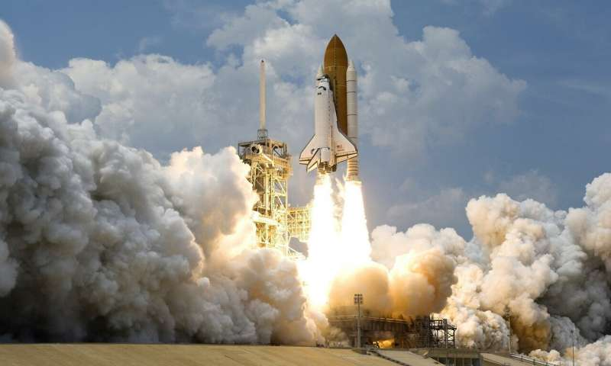
If ML is a rocket engine,
data is the fuel

Slide 77
Model Training

Slide 78
Model Training
DATA
MODEL

Slide 79
Model Training
Prediction
0
1
0
0
1
0
DATA
MODEL

Slide 80
Model Training
Prediction | Label
0 | 1
1 | 1
0 | 0
0 | 1
1 | 0
0 | 0
DATA
MODEL

Slide 81
Model Training
Prediction | Label
0 | 1
1 | 1
0 | 0
0 | 1
1 | 0
0 | 0
DATA
MODEL

Slide 82
Model Training
Prediction | Label
0 | 1
1 | 1
0 | 0
0 | 1
1 | 0
0 | 0
DATA
MODEL

Slide 83
Model Training
Prediction | Label
1 | 1
1 | 1
0 | 0
1 | 1
0 | 0
0 | 0
DATA
MODEL

Slide 84
Model Training
Prediction | Label
1 | 1
1 | 1
0 | 0
1 | 1
0 | 0
0 | 0
DATA
MODEL

Slide 85
Model Training
TRAINED MODEL

Slide 86
Model Training
MODEL
MODEL
MODEL
MODEL
MODEL

Slide 87
Evaluate the Model

Slide 88
Evaluate the Model
Training Data
Test Data

Slide 89
Train

Slide 90
Train
Test

Slide 91
Train
Test
Deploy

Slide 92
ML Process
Get Data
Prepare Data
Model Data
Refine Model
Deploy Model

Slide 93
ML Process
Get Data
Prepare Data
Model Data
Refine Model
Deploy Model
What data should you use?
Is it labeled?

Slide 94
ML Process
Get Data
Prepare Data
Model Data
Refine Model
Deploy Model
Is your data complete, clean, does it have coverage?

Slide 95
ML Process
Get Data
Prepare Data
Model Data
Refine Model
Deploy Model
Which algorithms should you use?

Slide 96
ML Process
Get Data
Prepare Data
Model Data
Refine Model
Deploy Model
What level of performance is sufficient?

Slide 97
ML Process
Get Data
Prepare Data
Model Data
Refine Model
Deploy Model
Make predictions.

Slide 98
Predictive Insights

Slide 99
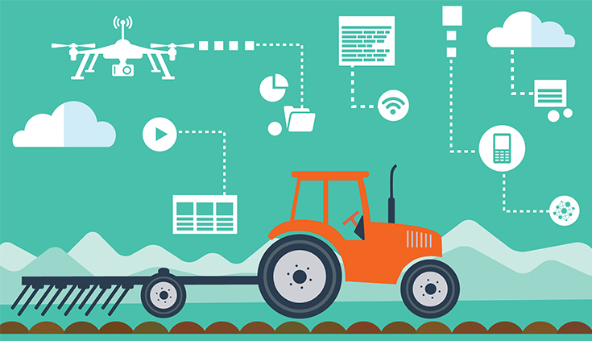
AgTech

Slide 100
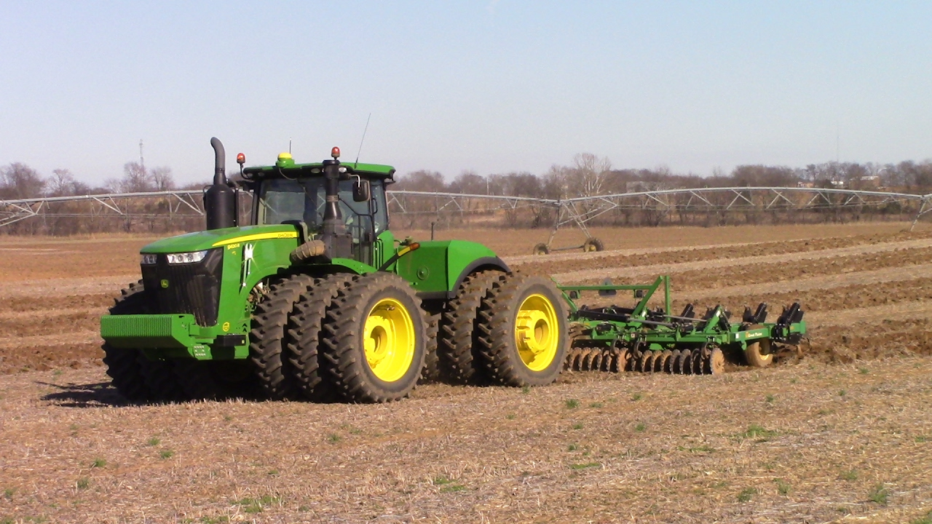
AgTech
Water Management
Plant Soil Analytics
Weather Forecasting
Predictive Machine Failure
Pest/Disease Identification

Slide 101
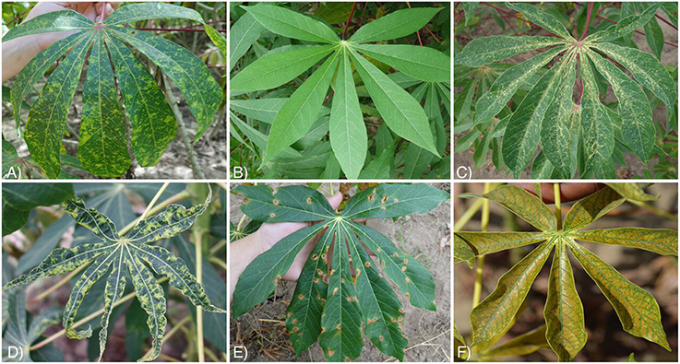

Slide 102
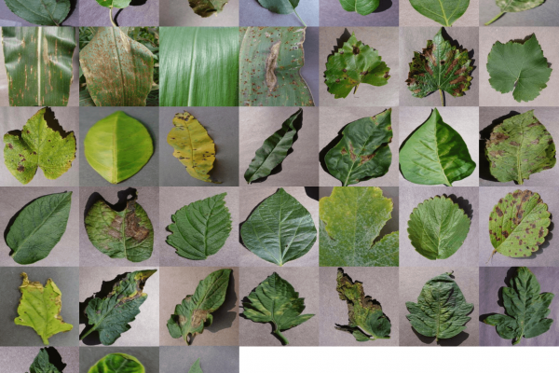

Slide 103
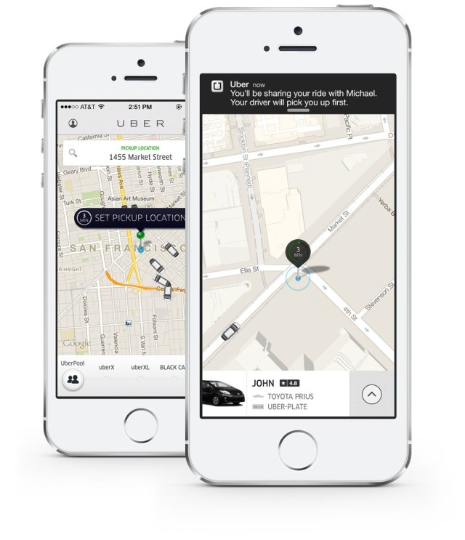


Slide 104
Machine Learning

Slide 105
Machine Learning
Supply-Demand

Slide 106
Machine Learning
Supply-Demand
Route Optimization

Slide 107
Machine Learning
Supply-Demand
Route Optimization
Rush Hour Pool

Slide 108
AI vs. Machine Learning

Slide 109
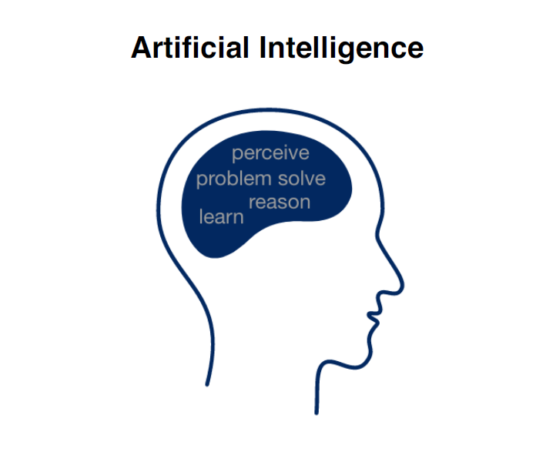

Slide 110
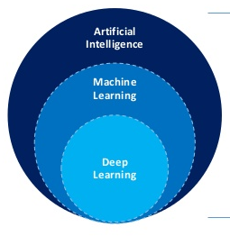
Machine Learning is a type of AI

Slide 111
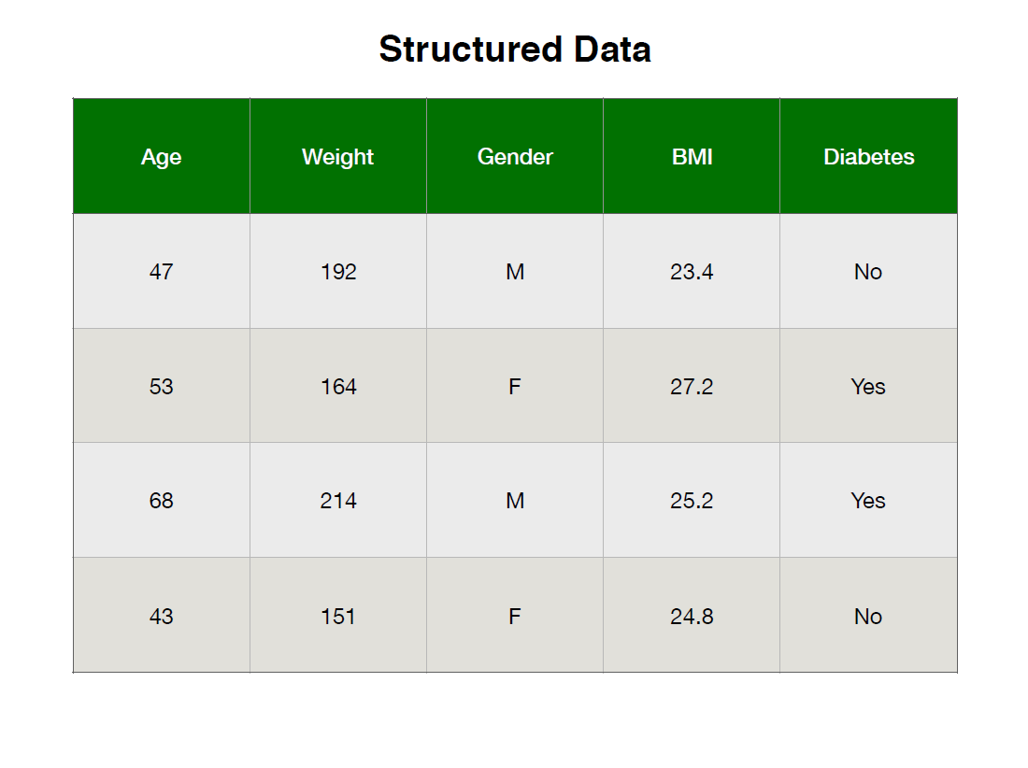

Slide 112
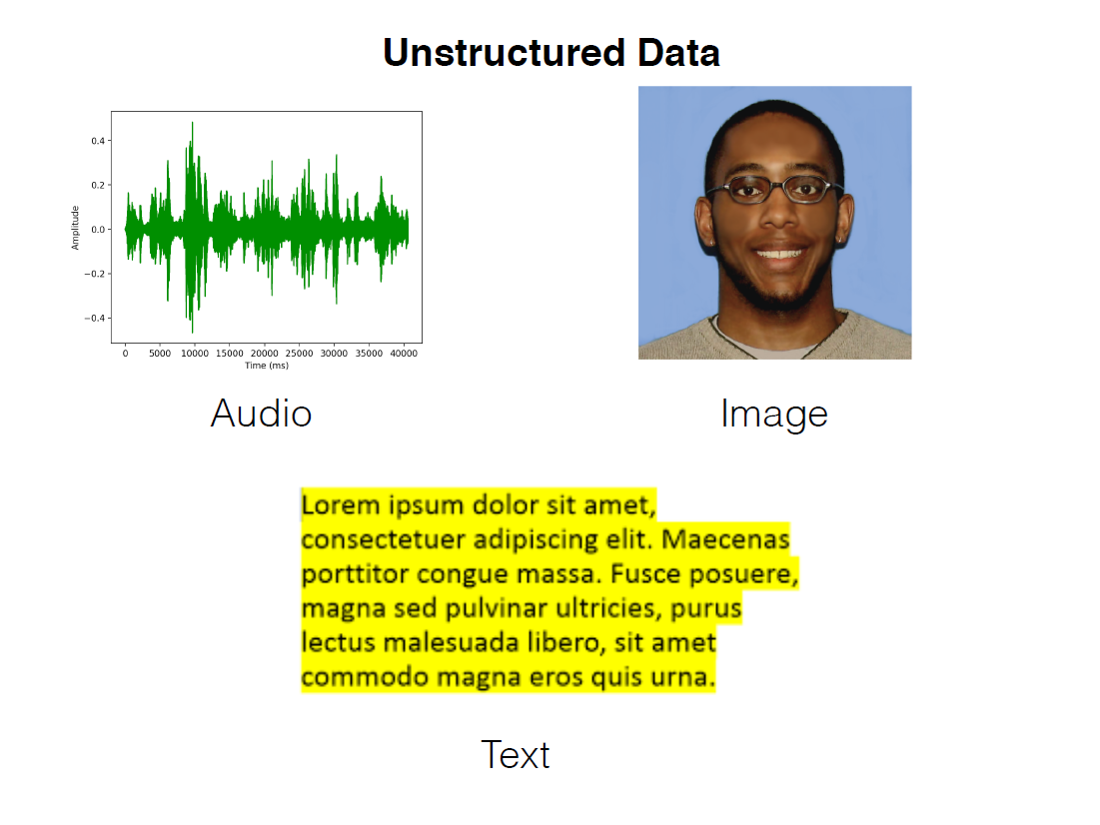

Slide 113
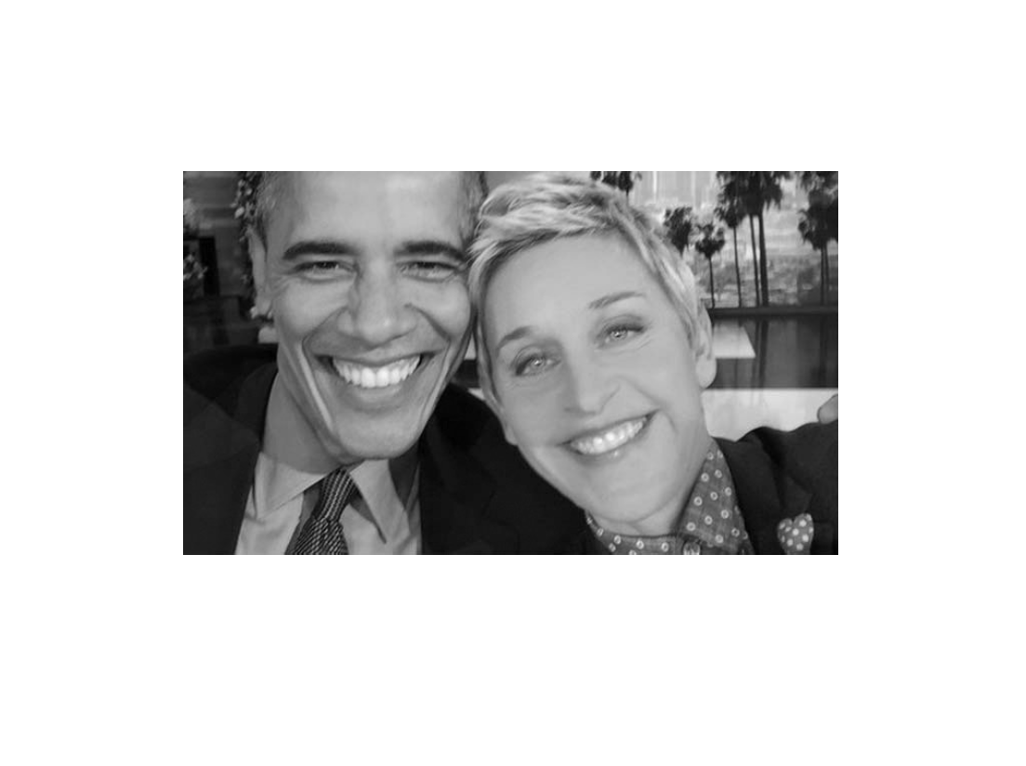

Slide 114
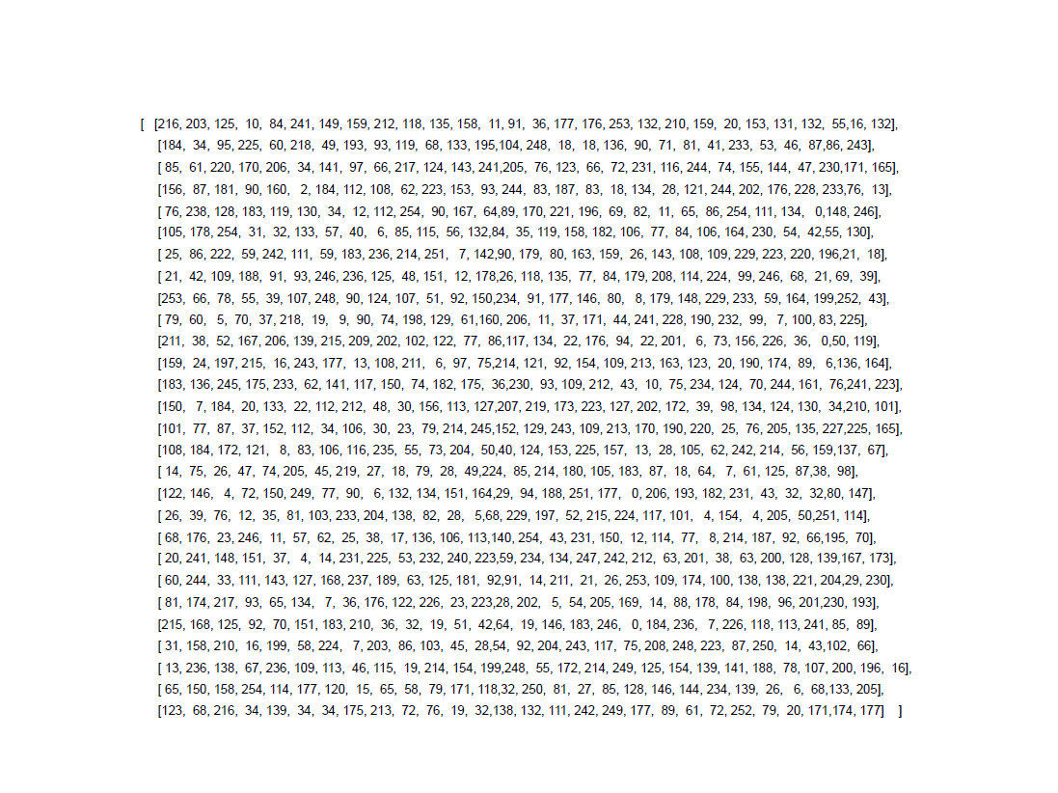

Slide 115
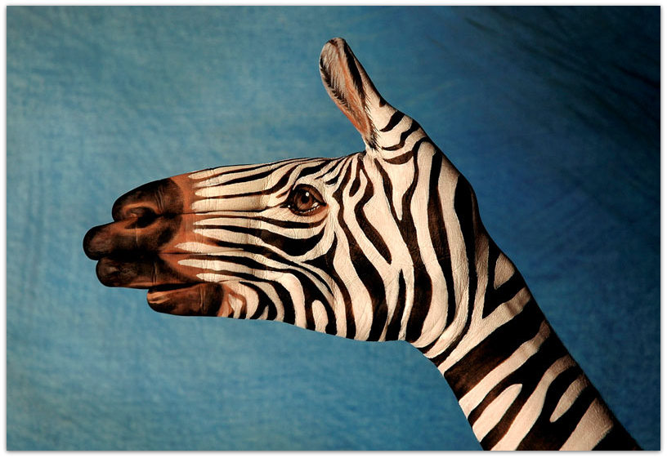

Slide 116




